Slide 1

A Presentation on Final Project TSS (Trainee Selection System)

Slide 2
Project Summary
TSS is a software platform designed to streamline and enhance the trainee selection process
TSS provides a user-friendly interface for trainees to submit their applications
TSS also offers admins to review and evaluate applications , approve trainees and generate admit cards
Internal mailing service is integrated for sending important notifications to the applicants

Slide 3
Feature List
Applicant’s Login/Registration
Application for desire circular
Approval of applicants for 3 categories(written , technical, hr)
Admit card generation
Track participants of the exam by generating unique code
Upload marks for 3 categories(written , technical & hr)
Internal mailing system
Applicant notice board
Select Final trainee list

Slide 4
Technologies / Tools
Intellij IDE used for backend and VS code is used for frontend as a tools for developing the software
The rest api’s is developed by Spring framework
The user interface is developed by React JS
Spring security is integrated for secure the project
Builder design pattern is used
MySQL Workbench is used for storing the data

Slide 5
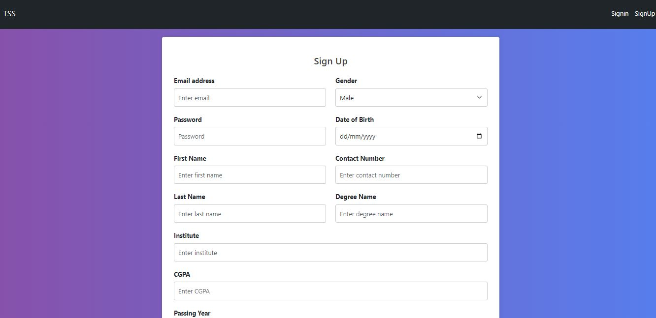
Screenshots of the UI (User Interface)

Slide 6
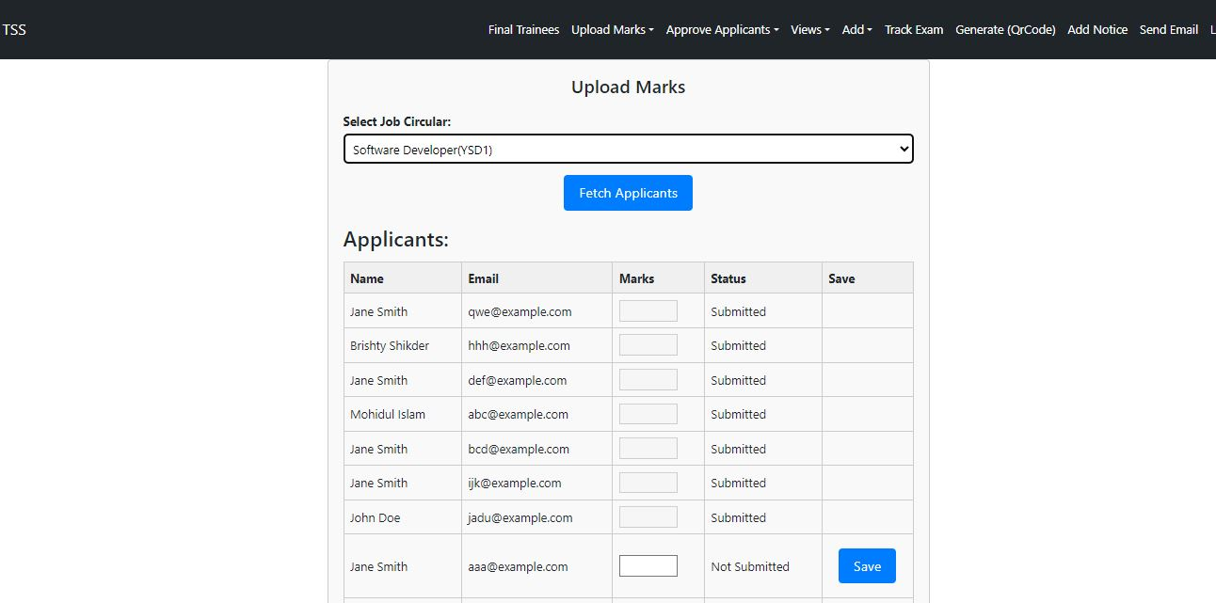
Screenshots of the UI (User Interface)

Slide 7
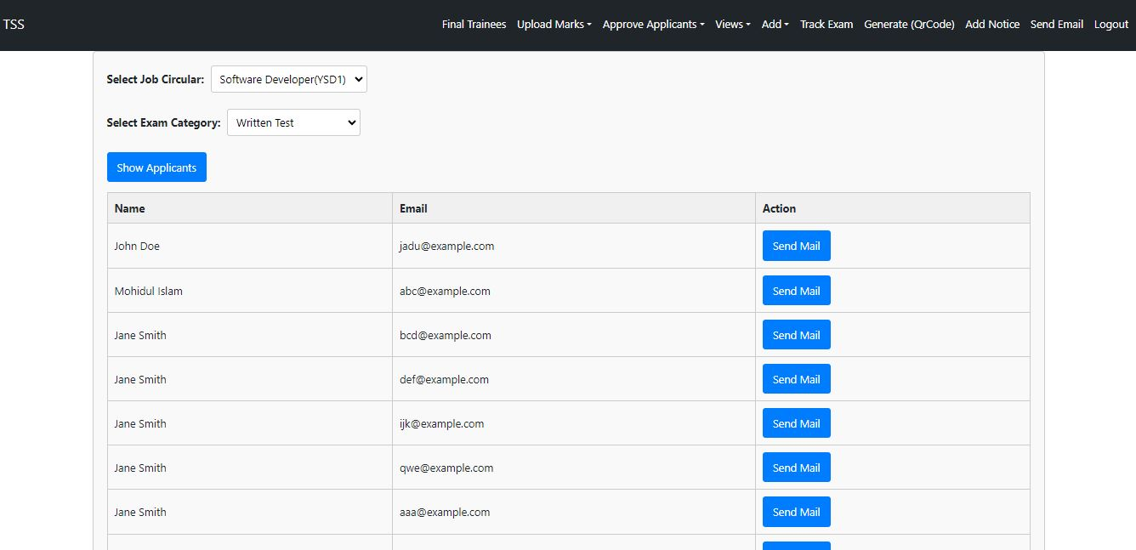
Screenshots of the UI (User Interface)

Slide 8
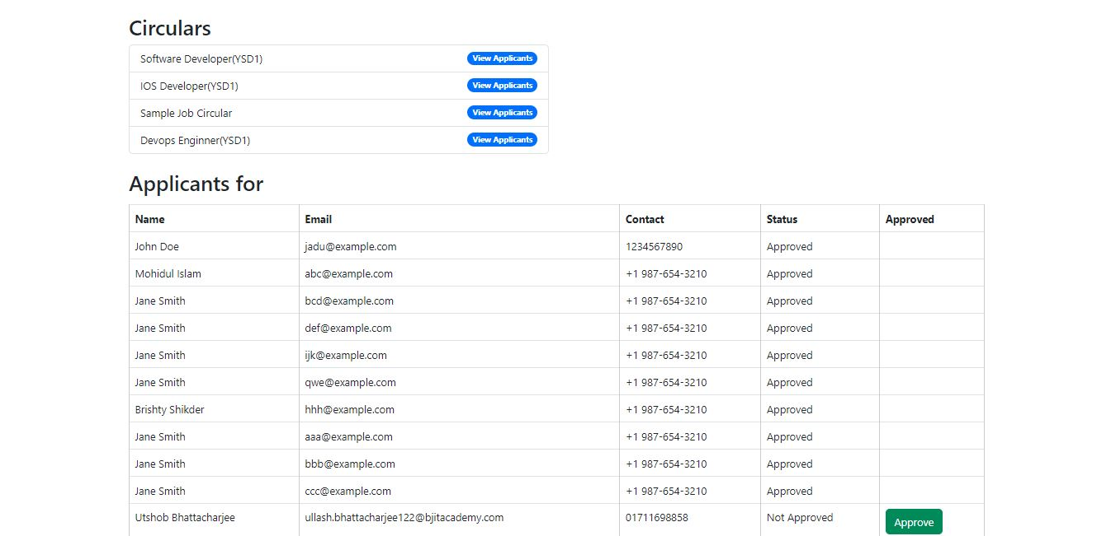
Screenshots of the UI (User Interface)

Slide 9
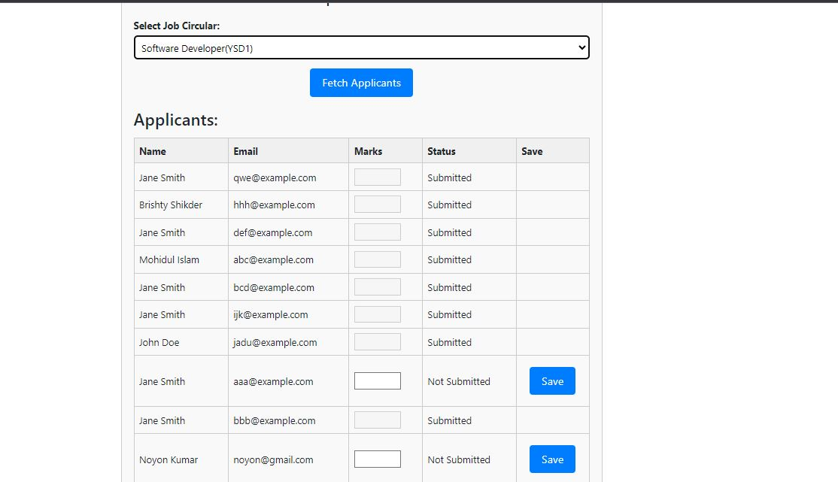
Screenshots of the UI (User Interface)

Slide 10
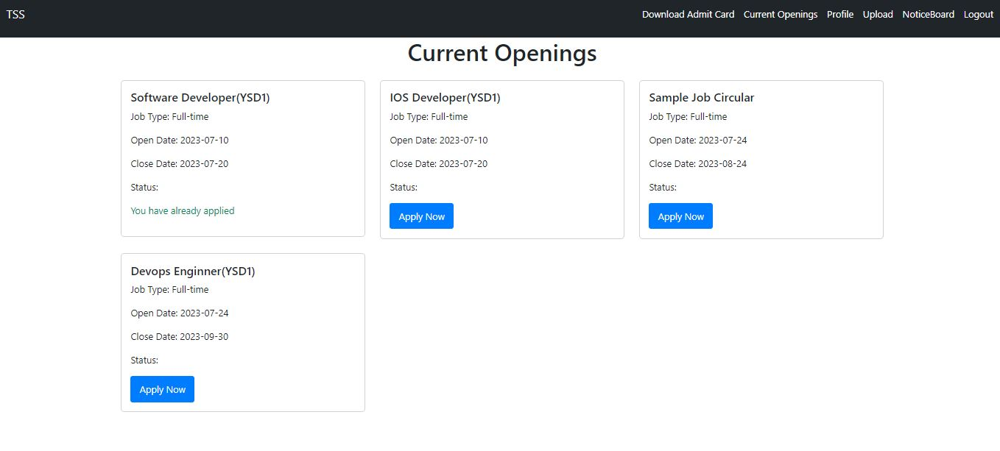
Screenshots of the UI (User Interface)

Slide 11
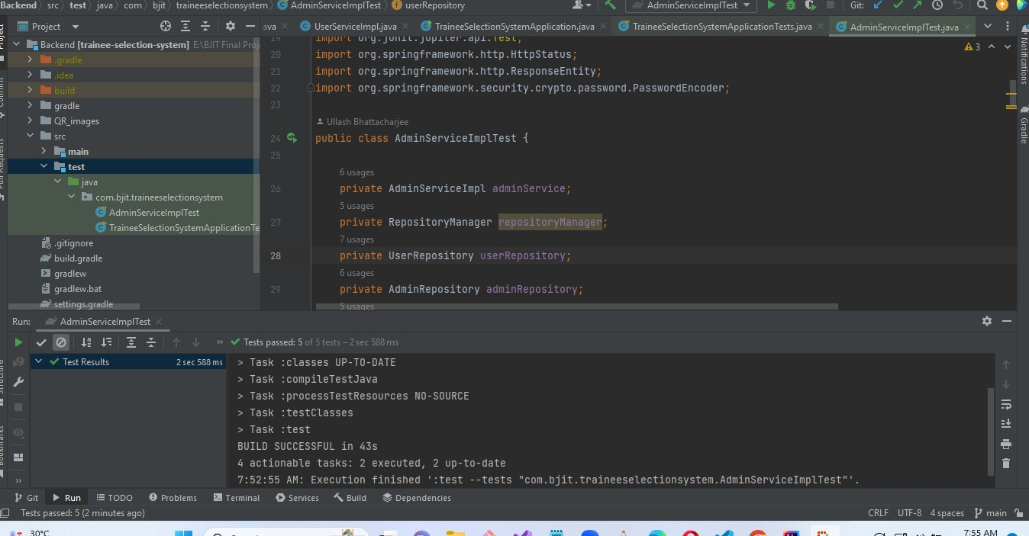
Unit test (Job Circular)

Slide 12
My Learnings
Experiencing to develop a real life application project
Understanding how to set up a spring boot project to build RESTful API’s
Can able to understand how to handle exceptions
Getting familiar with entity relationships , spring security and unit testing
Getting familiar with front end framework React JS, state management

Slide 13
Challenges
Facing some problems related to security while integrating frontend with the backend
Facing challenges about configuring CORS settings to allow or restrict cross-origin requests
During the front end development process facing many debugging errors as I learn React for the very first time
Facing problems to handle exceptions in front-end that is coming from the backend

Slide 14
Thank You

